Slide 1
Principal Component Analysis
WKSP 320 Module 1, Lesson 1
Notes:
Welcome to this lecture on Principal Component Analysis or PCA. This is a dimensionality reduction method that uses linear algebra to identify the most important or principal directions that are necessary to explain the data.

Slide 2
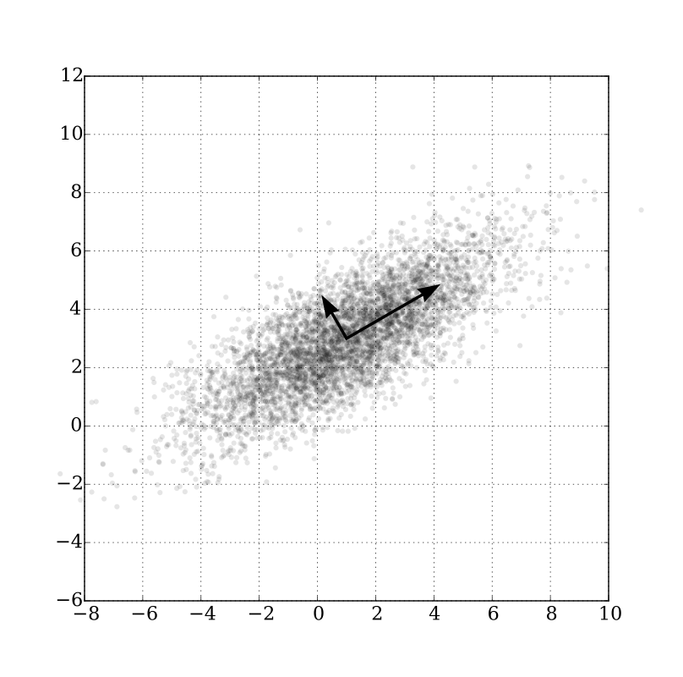
PCA and Dimensionality Reduction
Why and When:
Numerical data
Data = linear combination of eigenvectors
Original features are correlated
Notes:
So first off, let’s go over when it makes sense to use PCA.
You need to have numerical data. If your data is not numerical, then you need to convert it.
Next, there’s a constraint on the type of data for using PCA. In linear algebra, a matrix can sometimes be decomposed into what are called Eigenvectors.
You can think of eigenvectors as the most important vectors that explain the direction of the data. So the constraint is that you need to be able to decompose the data into eigenvectors. There are some cases where you can’t calculate eigenvectors from a matrix, but that is beyond the scope of this course.
So in this figure, we’re showing 2 arrows in bold that show the principal direction of this blob. Those are eigenvectors.
And lastly, PCA will also only be useful in reducing dimensionality of the variables are correlated. If all the variables were independent of each other, then you would need all of those variables to describe the data, and then you can’t reduce any of them.

Slide 3
Principal Component Analysis
Original Data
Covariance Matrix
X^{T}X
Eigenvalues + Eigenvectors
Transformed Data
Top n
Notes:
So let’s go over the theoretical steps involved in PCA.
First you take your original data and generate the covariance matrix. Basically, take the matrix and it’s transpose and do a matrix multiplication.
This is why PCA has limitations on data size. By computing the covariance matrix, if you have n variables, you create an n x n matrix.
So if you have 25000 variables, then you create a 25000 x 25000 matrix, which takes up a large amount of memory.
Once you have the covariance matrix, you’ll compute the eigenvectors and eigenvalues. There is one eigenvalue for each eigenvector. And generally, a larger eigenvalue means that eigenvector is more important.
So you can sort your eigenvalues and then choose the top n number of eigenvectors with the largest eigenvalues, and discard the rest. The new matrix with just these top eigenvectors will then be much reduced.

Slide 4
Directions of Variance
Notes:
This figure from Wikipedia shows a multivariate Gaussian distribution. Shown in bold are the eigenvectors of the covariance matrix.
They are orthogonal thanks to the covariance matrix.
They point in the direction of the most noise. The longer vector points to the direction of most noise.
Source: https://en.wikipedia.org/wiki/Principal_component_analysis#/media/File:GaussianScatterPCA.svg

Slide 5
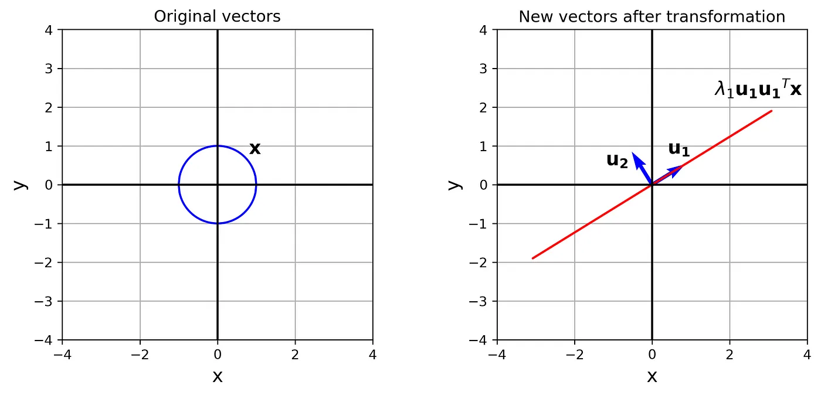
Unit Vector Transformation
Notes:
Here is an example of the transformation that happens in PCA.
This figure on the left shows a unit circle. There are 2 unit vectors, one in the X direction and one in the Y direction. This means that every point on the circle can be represented as a (X,Y) coordinate. However, for this shape, the circle’s X and Y values are perfectly correlated. So you can reduce these 2 dimensions to one rotated dimension shown on the right. That’s essentially that’s going on in PCA.
You first try to rotate the data in a way that identifies main dimensions where the data lies. Then you determine which smaller set of these dimensions describes most of the data.
----------------------------------------------------------------------------------------------------------------
This is from Reza Beghari’s excellent tutorial on Singular Vector Decomposition and it shows the original data x on the left and the transformed and stretched data on the right, where lambda1 is the eigenvalue and u1 and u2 are the original unit vectors. As the data along the X and Y axes in the original figure are perfectly correlated, the transformed data only requires one axis to convey all the information.
Source: https://towardsdatascience.com/understanding-singular-value-decomposition-and-its-application-in-data-science-388a54be95d

Slide 6
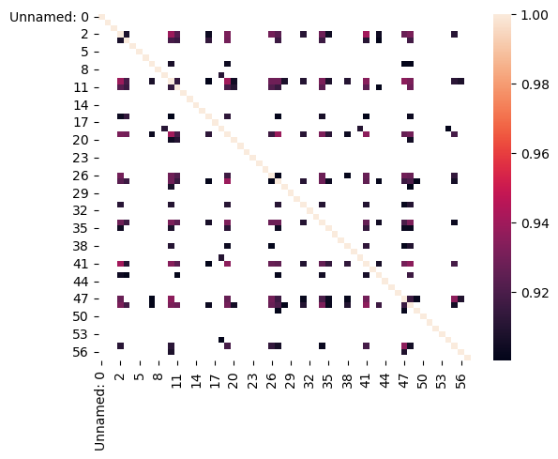
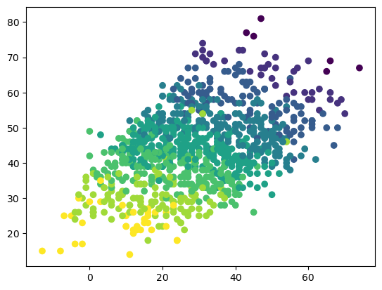
Examples
Variables with > 0.9 correlation
Notes:
Let’s see what this looks like with the DPA data:
Shown here on the left is a heatmap of variables in the DPA dataset that have a absolute correlation > 0.9.
On the right is a scatter plot of 1000 observations for 2 variables that have a correlation of 0.9. You can tell that the classes all roughly occupy their own space, with yellow on the bottom, then green, blue, etc. But there isn’t a distinct line that separates them and there’s some overlap.
This dataset has many highly correlated variables. It’s likely that this data can be transformed along new axes where much of this correlated data can be combined over a smaller handful of transformed dimensions.

Slide 7
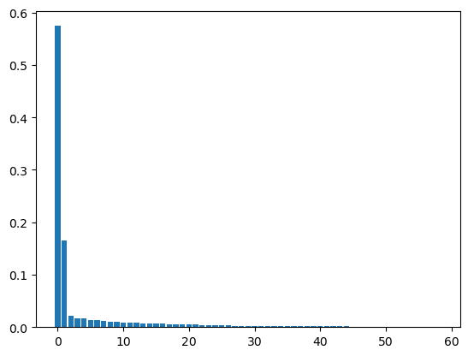
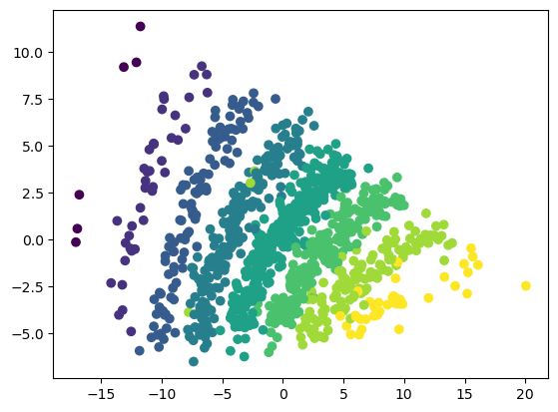
Transformed Data
Eigenvalues
First 2 Eigenvectors
Notes:
On the left are the sorted eigenvalues and we see that the first 2 represent a very large amount of the overall energy of the signal.
Using just the first 2 eigenvectors, we get the transformed scatter plot shown on the right. We see some clear separation of the classes.
It’s important to note that PCA is blind to the classes. That is, it does not use class labels as input and it doesn’t not guarantee that the transformed data will separate the classes in the best way.

Slide 8
Transformed Data
Eigenvalues
First 2 Eigenvectors
Notes:
On the left are the sorted eigenvalues and we see that the first 2 represent a very large amount of the overall energy of the signal.
Using just the first 2 eigenvectors, we get the transformed scatter plot shown on the right. We see some clear separation of the classes.
It’s important to note that PCA is blind to the classes. That is, it does not use class labels as input and it doesn’t not guarantee that the transformed data will separate the classes in the best way.
So next we’re going to go through a lab where we practice using PCA for dimensionality reduction.

